Slide 1
Lecture 4: Guest Lecture
Stanford CS106L, Spring 2025

Slide 2
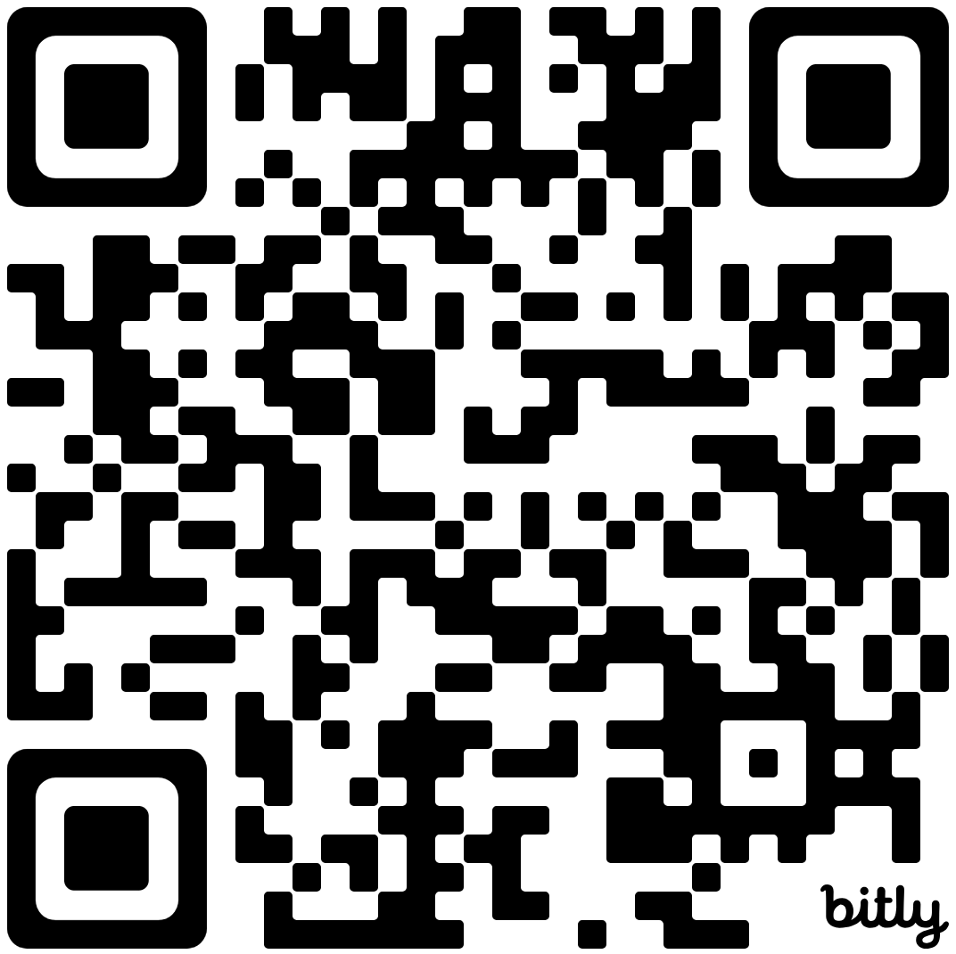
Link to Attendance Form
bit.ly/4j6txEF

